Slide 1
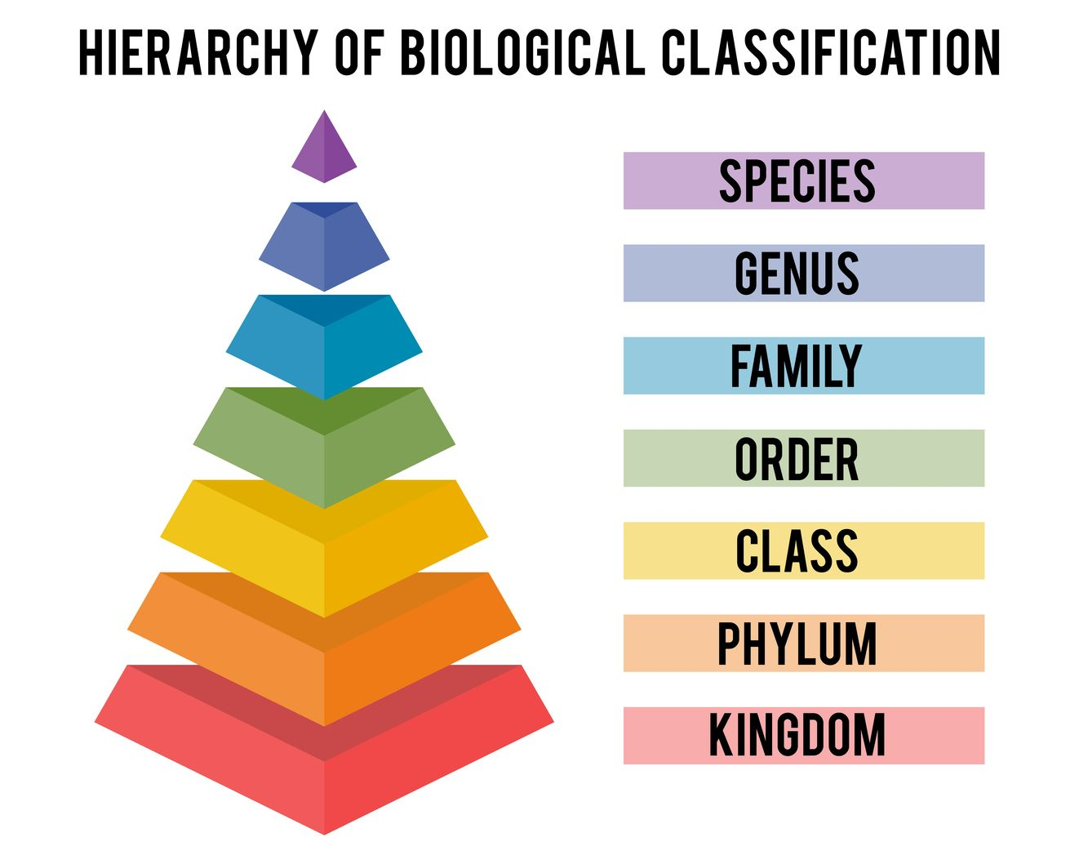
Linnaean Classification – Page 1
The Linnaeus classification system, also known as the Linnaean system, was developed by a Swedish scientist named Carl Linnaeus in the 18th century. This system is very important because it allows scientists all around the world to identify and classify all kinds of living organisms. Imagine you're in a library filled with thousands of books. The books are organized by categories, so you know where to find the one you need. Just like these books, the Linnaeus system organizes life on Earth into different categories.
Who developed the Linnaeus classification system? ___________________________________________________________________
Why is the Linnaeus classification system important? ___________________________________________________________________
What does the Linnaeus system organize? ___________________________________________________________________
The Linnaean system works by dividing life into several major categories, which we call "taxa". These are: Kingdom, Phylum, Class, Order, Family, Genus, and Species, arranged from broad to specific. For example, a human belongs to the Kingdom Animalia, the Phylum Chordata, the Class Mammalia, the Order Primates, the Family Hominidae, the Genus Homo, and the Species sapiens. This kind of organization helps us understand how closely related different organisms are.
What are the major categories in the Linnaean system? K_______________ P__________ C__________ O__________ F_______________ G__________ S__________
What species do humans belong to in the Linnaean system? ___________________________________________________________________
What does the organization of these categories help us to understand about different organisms? ___________________________________________________________________

Slide 2
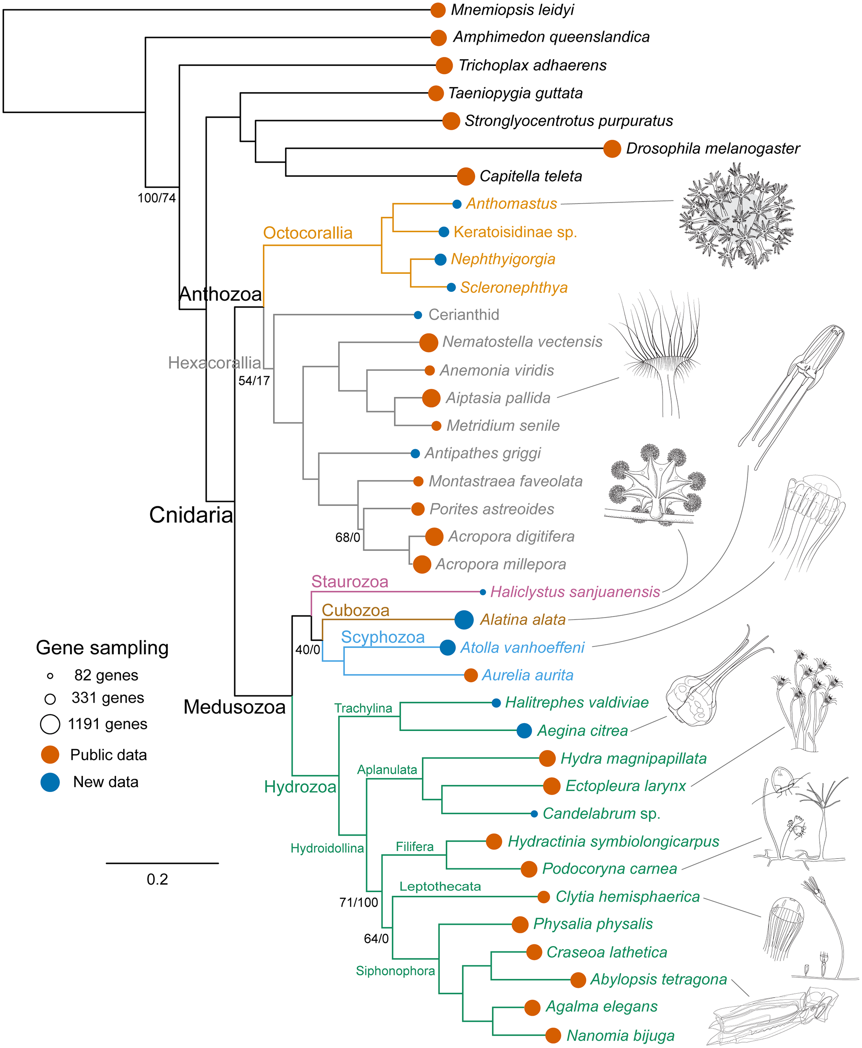
Linnaean Classification – Page 2
In the Linnaean system, each species is given a unique two-part name, also known as a binomial name. The first part of the name is the Genus, and the second part is the species. For example, the binomial name for humans is Homo sapiens. 'Homo' is the Genus, and 'sapiens' is the species. This system of naming is used worldwide, regardless of the language spoken, which makes communication among scientists easier.
How many parts does a binomial name have, and what are they? __________________________________________________________________
What is the binomial name for humans? __________________________________________________________________
Why is this system of naming used worldwide? __________________________________________________________________
Dogs have the genus “canis” and species “lupus”. What would their binomial name be? __________________________________________________________________
Although the Linnaean system has been very helpful for hundreds of years, scientists now use a more modern system called Phylogenetic systematics, or cladistics. This new system also uses the categories of the Linnaean system but adds more categories based on the evolutionary relationships among organisms. However, the basic ideas of the Linnaean system are still used today, helping us understand the incredible diversity of life on our planet.
What is the more modern system that scientists use today? __________________________________________________________________
Why are the basic ideas of the Linnaean system still important? __________________________________________________________________

